Slide 1
Group 2 Project
SRE EC2 Project, a production grade AWS infrastructure system
Dave Mak
Ray Tan
Jia Fu
Thiam Seng

Slide 2

Agenda
Introduction
System Architecture
CI/CD Pipeline & Terraform
AWS Infrastructure
Monitoring Infrastructure
Demo
Conclusion
Q & A

Slide 3
Introduction
Our Project mimic a production-grade AWS infrastructure system that demonstrates Site Reliability Engineering practices through automated deployment, multi-environment management, and comprehensive observability.
The project implements a complete infrastructure-as-code solution using Terraform, with continuous deployment via GitHub Actions and a monitoring stack based on Prometheus and Grafana.

Slide 4
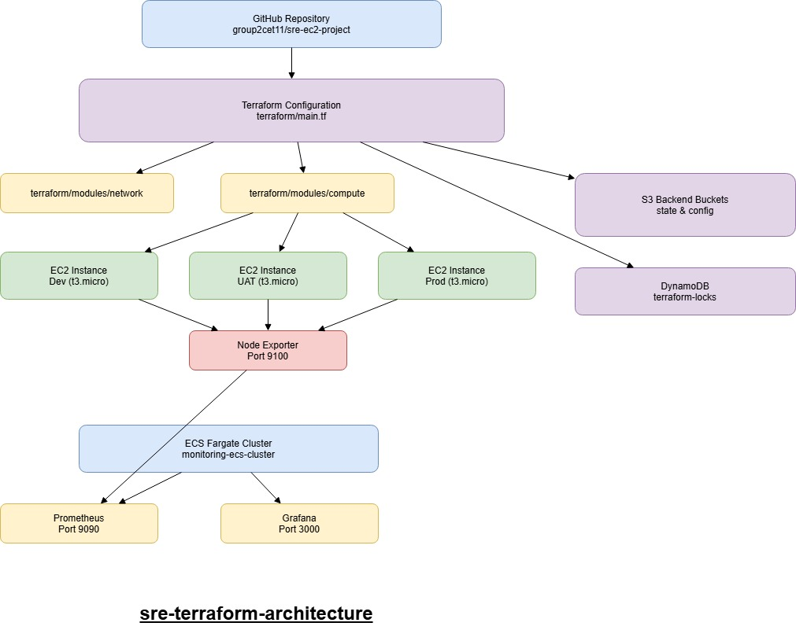
System Architecture

Slide 5
Sub Systems

Slide 6
CI/CD Pipeline & Terraform
The CI/CD pipeline uses GitHub Actions to orchestrate infrastructure deployments across multiple environments (dev, uat, prod) and manage the monitoring stack.
The pipeline handles authentication via AWS OIDC, executes Terraform workflows, and enforces manual approval gates for production deployments.

Slide 7
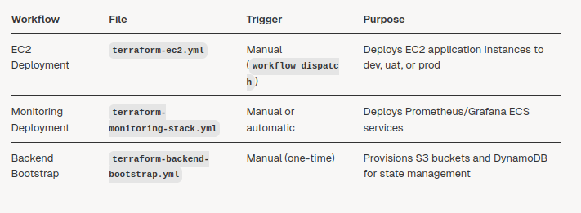
CI/CD Pipeline
The CI/CD system consists of three primary GitHub Actions workflows that automate infrastructure provisioning and updates:
Each workflow follows the same foundational pattern: authenticate to AWS via OIDC, initialize Terraform with environment-specific backend configuration, validate and plan infrastructure changes, and apply the changes after appropriate approvals.

Slide 8
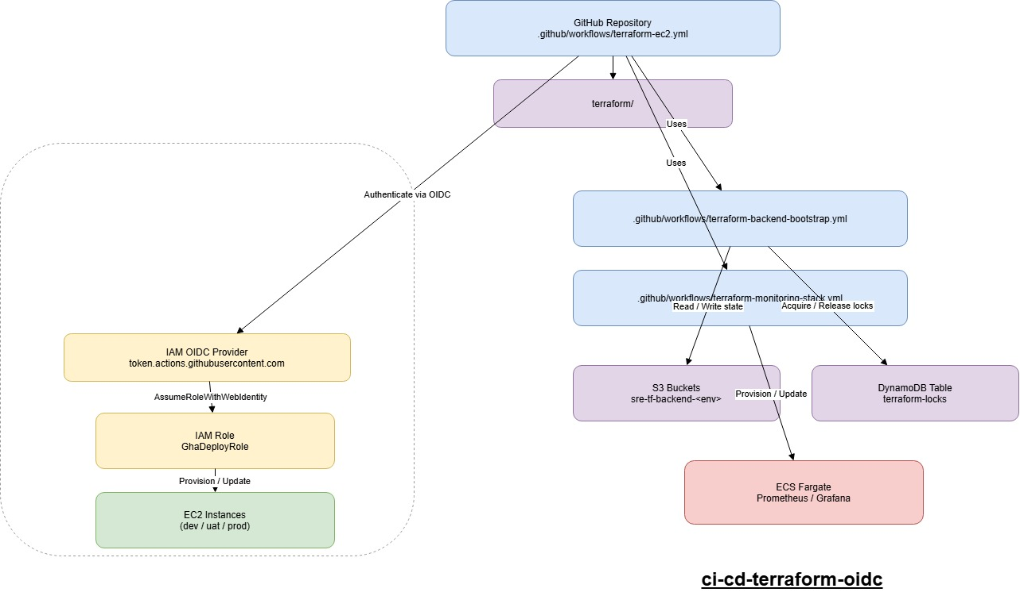
CI/CD Architecture

Slide 9
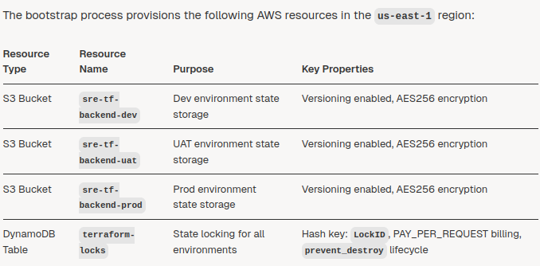
Backend Bootstrap Process
This is a one-time setup process for provisioning the foundational Terraform backend infrastructure.
The bootstrap process creates the S3 buckets and DynamoDB table required for remote state storage and state locking across all Terraform deployments in the project.

Slide 10
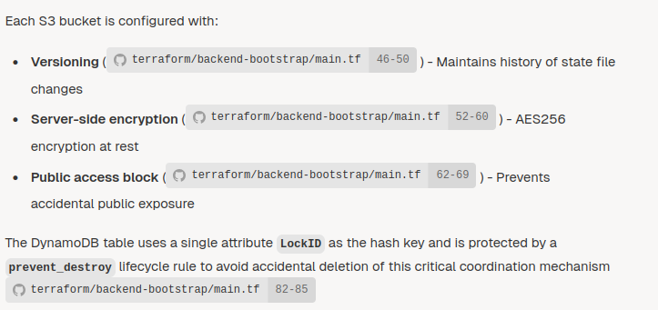
Backend Bootstrap Process

Slide 11
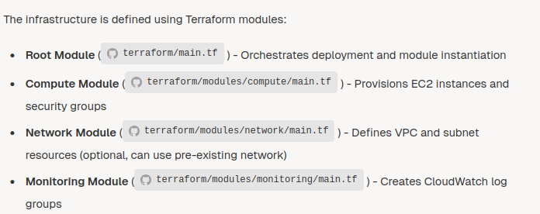
Application Overview
The application infrastructure consists of EC2 instances deployed into a VPC with public subnets across multiple availability zones.
Each instance runs Node Exporter for metrics collection and is configured with appropriate security groups for HTTP, SSH, and metrics access.

Slide 12
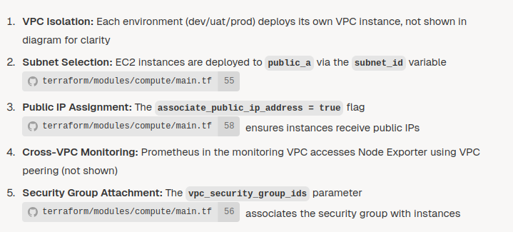
AWS Infrastructure

Slide 13
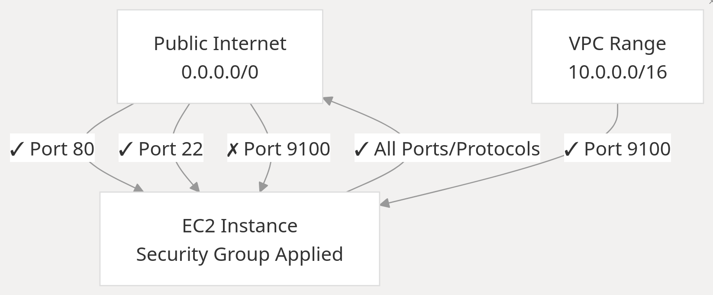
Network Security Model – Access Control

Slide 14
Monitoring Infrastructure
An overview of the monitoring infrastructure that collects metrics from all application environments (dev, uat, prod).
The system uses Prometheus for metric collection and storage, and Grafana for visualization, both running as containerized services on AWS ECS Fargate.
The infrastructure is deployed in a dedicated monitoring VPC and uses EC2 service discovery to automatically detect and scrape metrics from application instances across all environments.

Slide 15
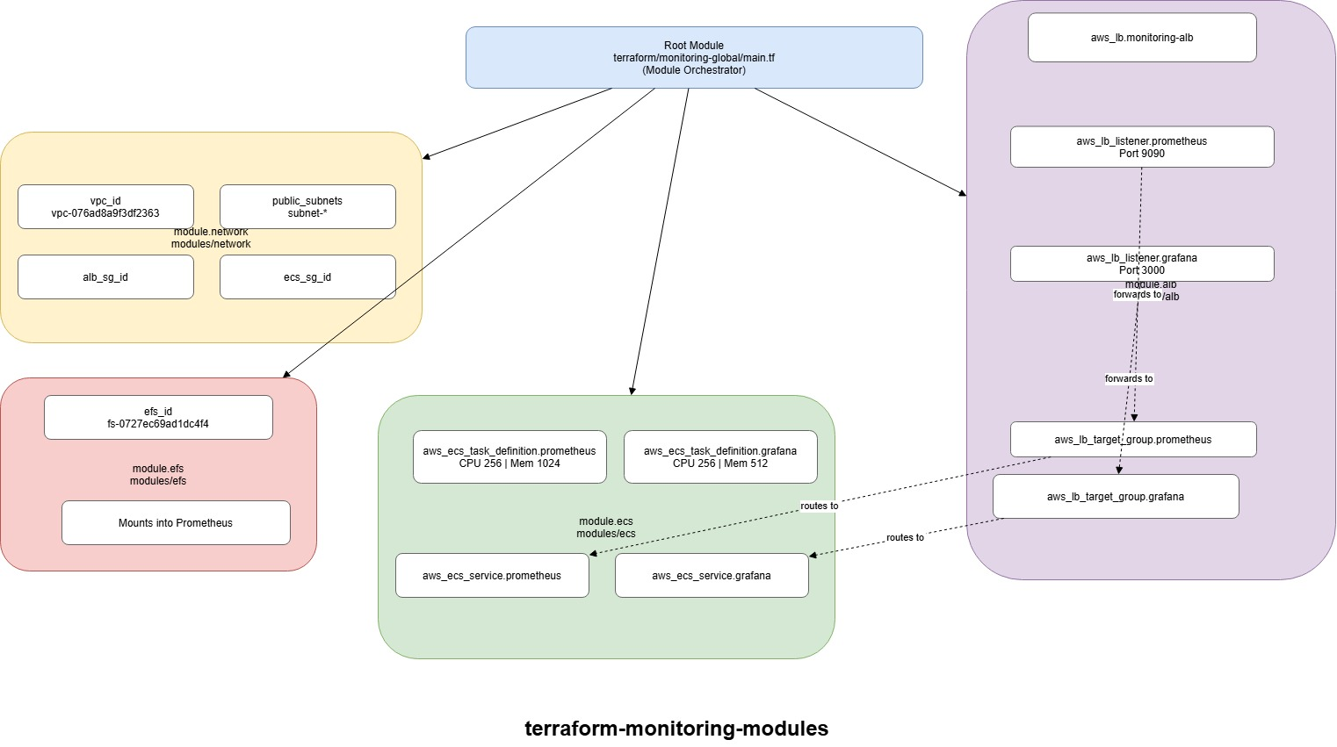
Monitoring Architecture

Slide 16
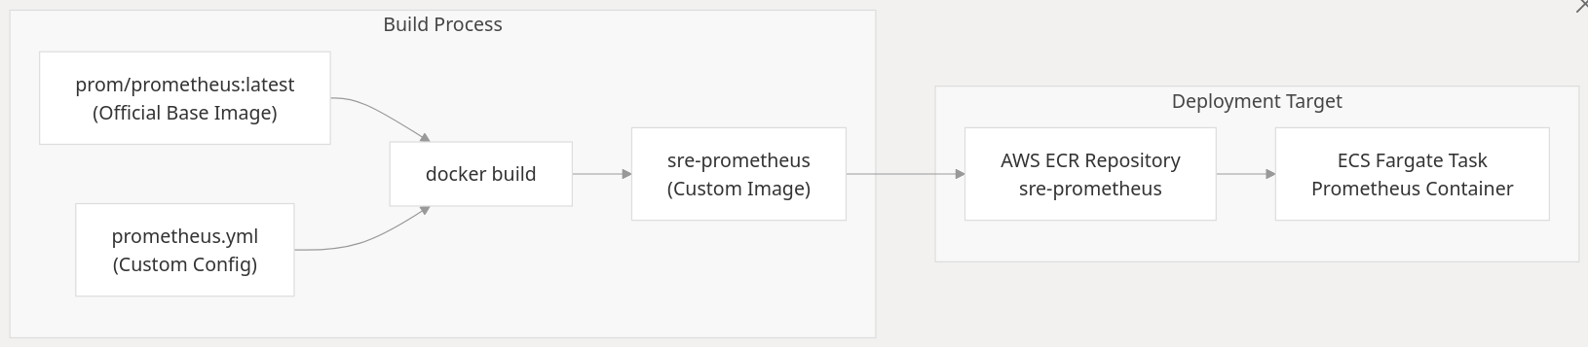
Dockers
The monitoring infrastructure uses two primary container images deployed on ECS Fargate

Slide 17
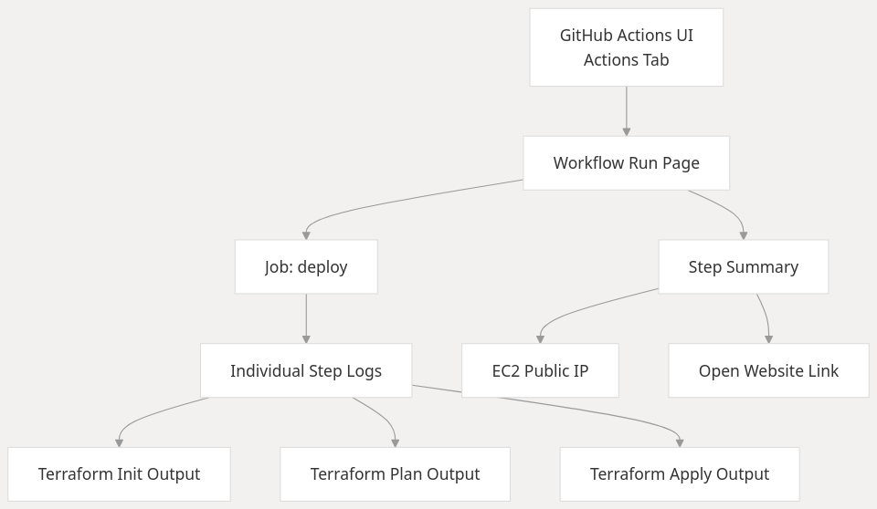
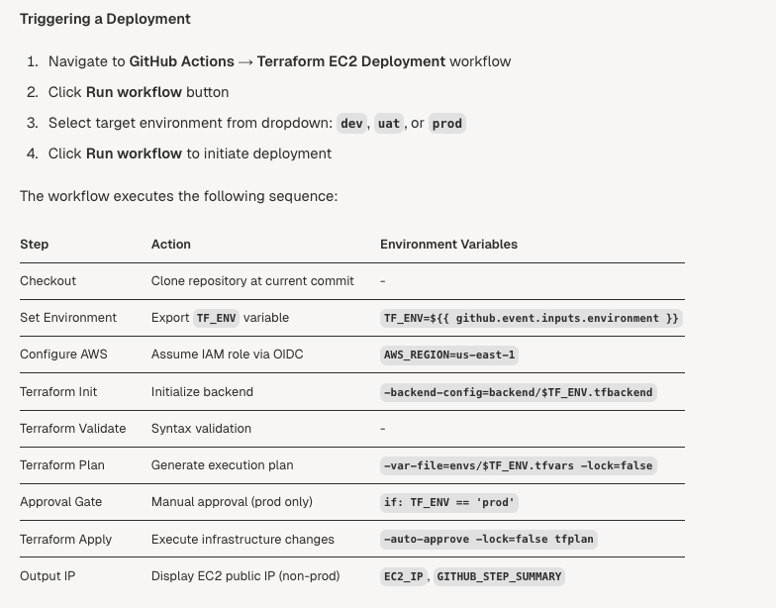
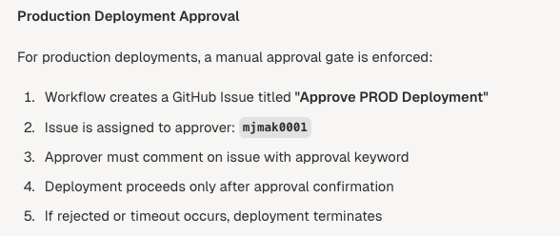
Operational Procedures

Slide 18

DEMO

Slide 19
Conclusion
Reliability by Design
Infrastructure is fully automated using Terraform, ensuring consistent, repeatable, and low-risk EC2 deployments across environments.
Safe & Controlled Change Management
CI/CD pipelines with environment separation and approval gates reduce deployment risk and prevent accidental production impact.
Strong Observability Foundation
Centralized monitoring with Prometheus and Grafana enables proactive detection, performance visibility, and capacity planning.
Learning Experience
Time Management
Issues with Coding
AWS & Infrastructure Issues

Slide 20

Q & A
Group 2

